Slide 1
CORE VALUES TO WORK UPON AS PER AWES AT HIGHER SECONDARY LEVEL

Slide 3
WHAT DO YOU MEAN BY CORE ?
A basic, essential, or enduring part.
The central or most important part of something.

Slide 4
TERMS RELATED TO THE WORD ‘CORE’
Core subjects (= subjects that all the students have to study) such as English and mathematics.
The core curriculum [the subjects that all the pupils have to study]
Core group
Core : a layer of earth.
The hard centre of certain fruits, containing seeds.

Slide 5
WHAT ARE VALUES?
Values are basic and fundamental beliefs that guide or motivate attitudes or actions. They help us to determine what is important to us. Values describe the personal qualities we choose to embody to guide our actions; the sort of person we want to be; the manner in which we treat ourselves and others, and our interaction with the world around us. They provide the general guidelines for conduct.

Slide 6
CLASSICAL V/S MODERN

Slide 7
CORE VALUES:
Core values are personal ethics or ideals that guide you when making decisions, building relationships and solving problems. The values that are meaningful to you and can help you to develop and achieve personal and professional goals.

Slide 8
CORE VALUES

Slide 9
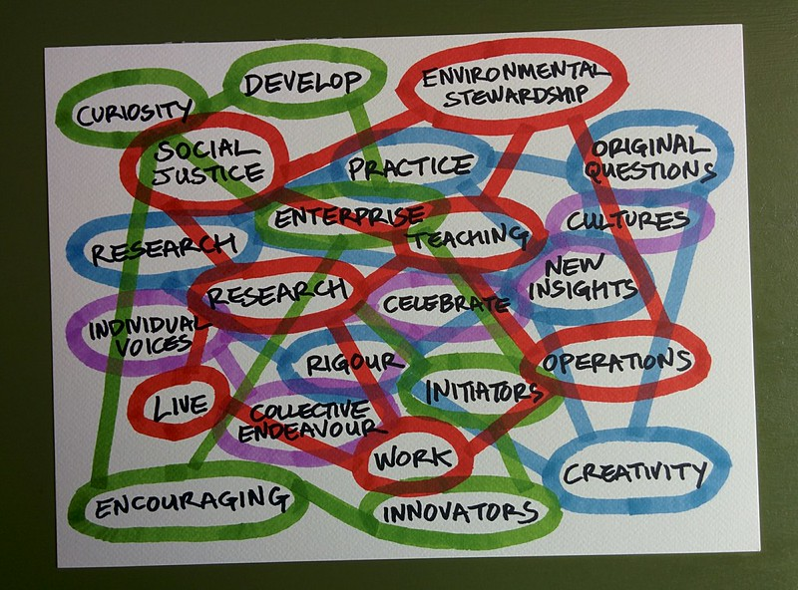
This Photo by Unknown Author is licensed under CC BY

Slide 11
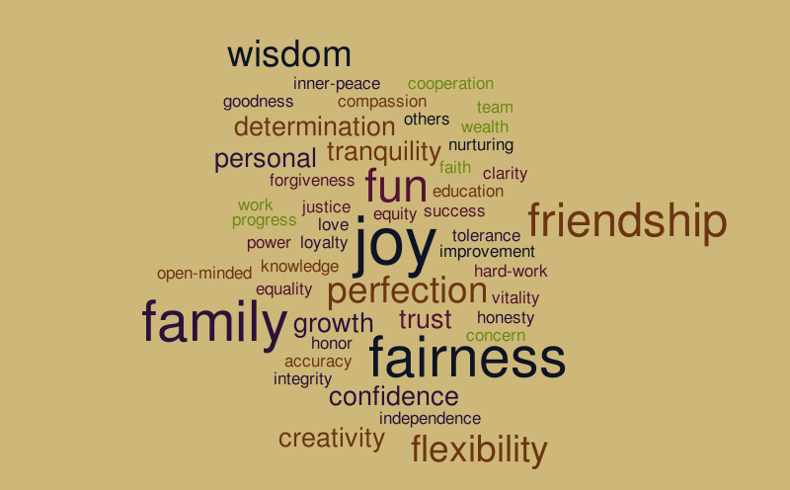

Slide 12
OBJECTIVE FOR DEVELOPING CORE VALUES:
The AWES (Army Welfare Education Society) emphasizes core values in the curriculum to develop Holistic Personality and to provide Holistic Education to the students .

Slide 13
CORE VALUES TO WORK UPON AS PER AWES AT HIGHER SECONDARY LEVEL:
INTEGRITY & HONESTY
RESPONSIBILITY & ACCOUNTABILITY
RESPECT & EMPATHY
DISCIPLINE & SELF REGULATION
COLLABORATION & TEAM WORK
PERSERVERANCE AND RESILIENCE
CREATIVITY & INNOVATION
ENVIRONMENTAL AWARENESS & RESPONSIBILITY
GLOBAL AWARENESS & CITIZENSHIP
PATRIOTISM & NATIONAL PRIDE
ETHICAL DECISION – MAKING & FAIRNESS
LIFELONG LEARNING & ADAPTABILITY

Slide 14
1. Integrity and Honesty 🤝
Encourage honesty in academic work 📚
Promote ethical behavior in assessments 📏
Foster a respectful attitude toward others' work and opinions 👂
2. Responsibility and Accountability 📋
Assign roles in group projects 🔄
Track completion of assignments ✅
Encourage self-reflection on individual contributions 🧠

Slide 15
3. Respect and Empathy 💖
Promote active listening and cultural awareness 🌏
Develop conflict resolution skills 🤝
Foster an inclusive environment for all students 🤗
4. Discipline and Self-Regulation ⏳
Implement time management exercises ⏰
Set academic and personal goals 🎯
Encourage adherence to rules and responsibilities📜

Slide 16
5. Collaboration and Teamwork 🤝
Engage students in group projects and peer mentoring 🤝
Organize sports and activities requiring cooperation 🏆
Build a sense of team spirit 💪
6. Perseverance and Resilience 💪
Encourage persistence through difficult tasks 🔄
Recognize effort and growth over results 🌱
Teach coping strategies for setbacks 💼

Slide 17
7. Creativity and Innovation 🎨
Assign projects that allow creative expression 💡
Encourage innovative problem-solving in academics 🧩
Promote participation in creative clubs or competitions 🏅
8. Environmental Awareness and Responsibility 🌍
Organize eco-friendly campaigns 🌱
Emphasize sustainable practices ♻️
Involve students in environmental conservation projects 🐢

Slide 18
9. Global Awareness and Citizenship 🌏
Host cultural exchange events 🌐
Discuss global issues and respect for diversity 💬
Encourage participation in global awareness initiatives 🌎
10. Patriotism and National Pride
Observe national holidays and celebrate heritage 🏵️
Engage students in discussions on civic responsibilities 🗣️
Reinforce a sense of pride and duty toward the nation 🏛️

Slide 19
11. Ethical Decision-Making and Fairness ⚖️
Role-play ethical dilemmas in real-life scenarios 🎭
Encourage fair play and sportsmanship 🏅
Reinforce integrity in all school activities 🤝
12. Lifelong Learning and Adaptability 📘
Cultivate a growth mindset in learning 🧠
Emphasize the importance of skill development 🛠️
Encourage curiosity and independent learning 🔍

Slide 20
Integration in Curriculum 📚
Cross-Disciplinary Approach: Embed values across subjects to reinforce concepts from multiple perspectives 🔄
Extracurricular Activities: Use clubs, events, and community service to provide practical experience with core values 🏫
Assessments and Reflections: Implement assignments and reflections to encourage self-evaluation in these values ✍️

Slide 22
PRESENTED BY:
PRIYANKA KHERAJANI
PGT (MATHS)
APS, NSD.

