Slide 1
Army public school Nasirabad
Holistic Personality Development in Secondary Level
Presented by- Shilu Tiwari
(TGT BIOLOGY)

Slide 2
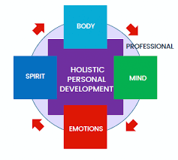
Introduction
Definition of Holistic Personality Development
Focus on intellectual, emotional, social, physical, and spiritual growth.
Importance for Secondary Students
Foundation for future success and well-being.

Slide 3
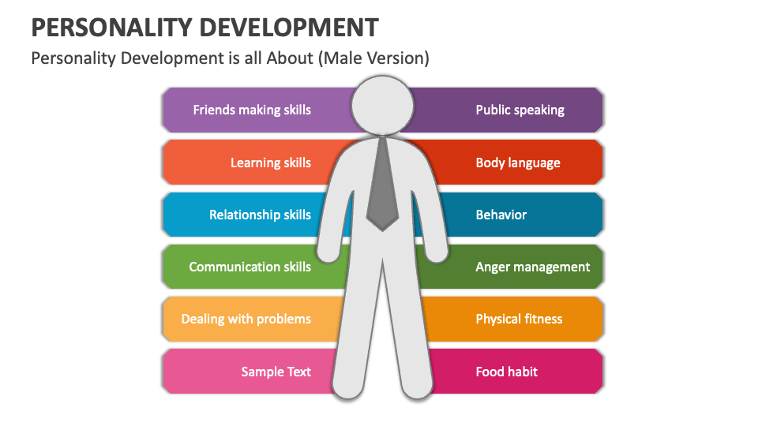
Key Components of Holistic Development
Intellectual Growth
Critical thinking, creativity, and problem-solving.
Emotional Development
Self-awareness, empathy, and emotional regulation.
Social Skills
Communication, teamwork, and conflict resolution.
Physical Development
Health, fitness, and wellness.
Spiritual Awareness
Values, ethics, and personal beliefs.

Slide 4
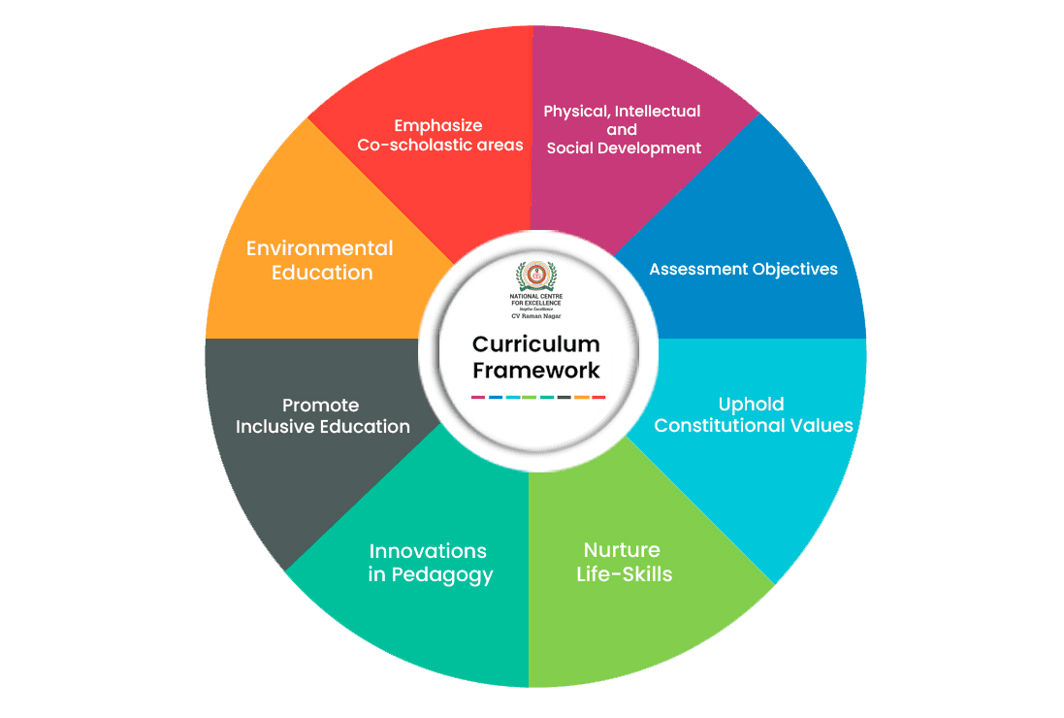
Intellectual Development Strategies
Encouraging Curiosity
Inquiry-based learning and exploration.
Critical Thinking Exercises
Debates, discussions, and project-based learning.

Slide 5
Emotional Development Techniques
Mindfulness Practices
Stress management and emotional regulation.
Journaling
Self-reflection and personal growth tracking.

Slide 6
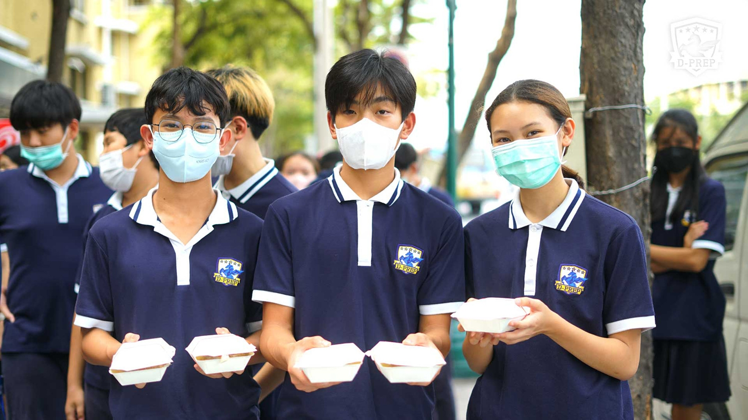
Fostering Social Skills
Group Activities
Team projects, clubs, and sports.
Role-Playing Scenarios
Enhancing communication and empathy.

Slide 7
Physical Development Activities
Encouraging Sports and Exercise
Importance of physical health.
Healthy Lifestyle Choices
Nutrition education and wellness programs.

Slide 8
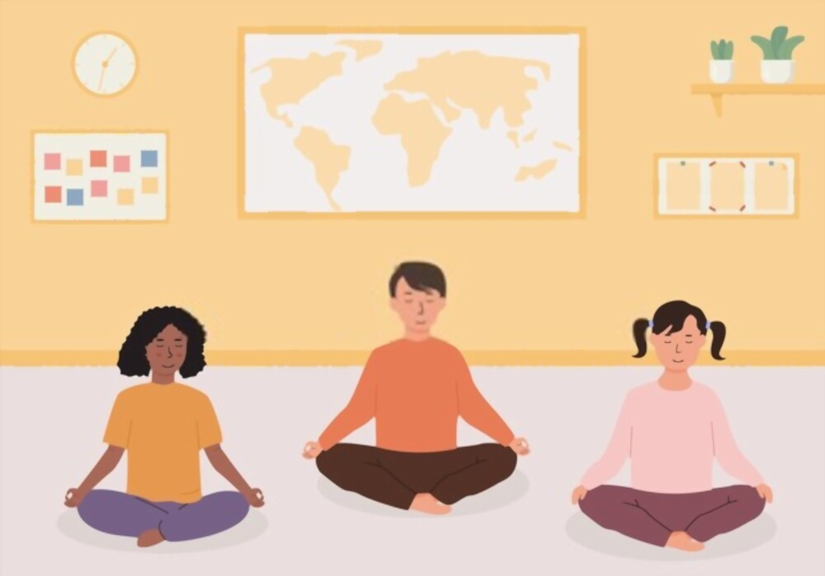
Spiritual Development Insights
Values Education
Discussions on ethics and personal beliefs.
Community Service
Building a sense of purpose and belonging.

Slide 9
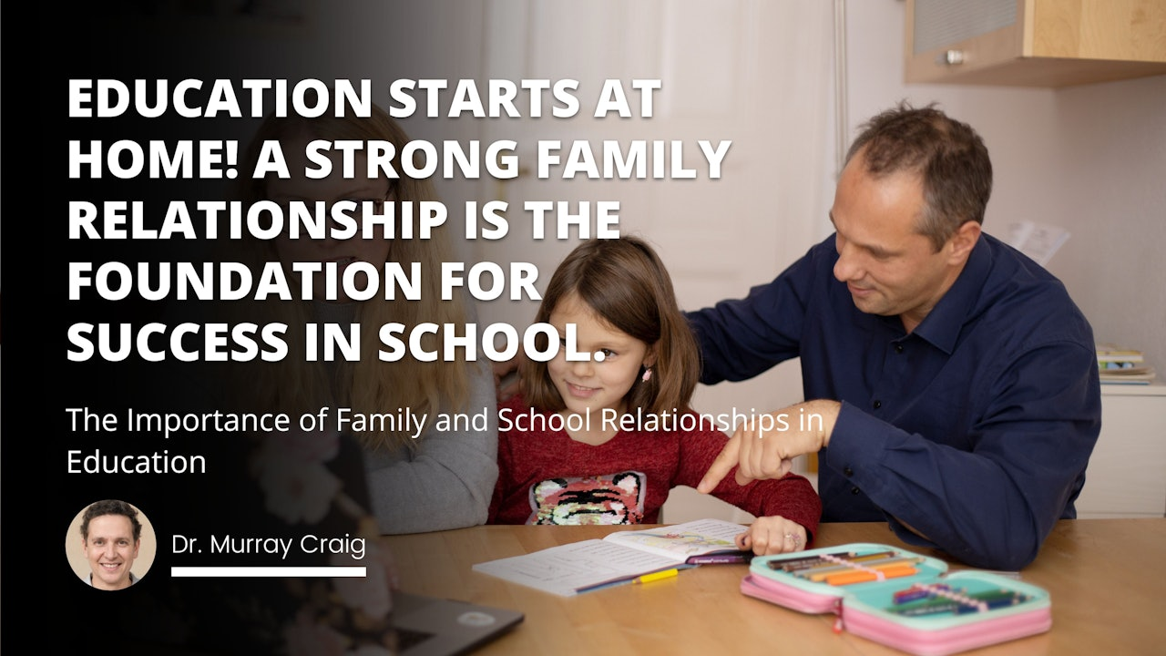
The Role of Educators and Parents
Collaboration for Holistic Development
Importance of a supportive environment.
Creating Opportunities for Growth
Encouraging participation in various activities.

Slide 10
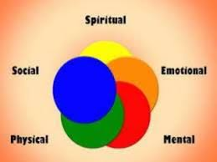
Conclusion
Summary of Key Points
Holistic development is essential for well-rounded individuals.
Call to Action
Encourage involvement in diverse activities to foster growth.

Slide 11
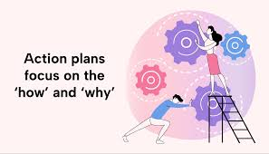
Action Plan for Holistic Personality Development
Objective:
To promote the holistic personality development of secondary students through structured programs and activities that enhance their intellectual, emotional, social, physical, and spiritual growth.

Slide 12
Step 1: Assessment and Planning
Actions:
Conduct surveys and focus groups with students, teachers, and parents to identify current strengths and areas for improvement.
Review existing programs and resources available for personality development.
Step 2: Curriculum Integration
Actions:
Collaborate with educators to integrate holistic development concepts into existing curricula.
Develop lesson plans that incorporate activities focused on critical thinking, emotional intelligence, social skills, and wellness.

Slide 13
Step 3: Extracurricular Activities
Actions:
Establish clubs and groups focused on various aspects of personality development (e.g., debate club, sports teams, mindfulness groups).
Organize workshops and seminars on topics such as emotional regulation, teamwork, and physical health.
Step 4: Teacher and Staff Training
Actions:
Conduct professional development sessions for teachers on holistic education strategies and student engagement.
Provide resources and tools for teachers to support students’ development effectively.

Slide 14
Step 5: Parent Involvement
Actions:
Host informational sessions for parents on the importance of holistic development and how they can support their children at home.
Create a communication plan for ongoing updates and resources for parents.
Step 6: Implementation of Programs
Actions:
Launch the integrated curriculum and extracurricular activities.
Monitor student participation and engagement in new programs.

Slide 15
Step 7: Evaluation and Feedback
Actions:
Collect feedback from students, parents, and teachers on the effectiveness of the programs.
Analyze data to assess improvements in student well-being and development.
Step 8: Continuous Improvement
Actions:
Use evaluation results to refine and enhance programs.
Set long-term goals for ongoing personality development initiatives.

Slide 16
As per the NEP 2020
The National Education Policy (NEP) 2020 emphasizes a holistic approach to education, particularly at the secondary level, to foster well-rounded personality development in students. Here are key aspects of how NEP 2020 promotes holistic personality development:

Slide 17
.1 Interdisciplinary Learning
Encourages integration of subjects, allowing students to see connections between different fields of knowledge.
Promotes critical thinking, creativity, and problem-solving skills.
2. Skill Development
Focus on vocational education and skill development, preparing students for diverse career paths.
Introduction of courses that enhance practical skills alongside academic knowledge.
3. Emphasis on Values and Ethics
Incorporates moral and ethical education, instilling values like empathy, respect, and responsibility.
Encourages students to engage in community service and social initiatives.

Slide 18
4. Physical and Mental Well-Being
Recognition of the importance of physical education and sports for overall development.
Initiatives for mental health awareness and support systems in schools.
5. Personalized Learning
Promotes learner-centered approaches, allowing students to pursue areas of interest.
Encourages self-directed learning and fosters a sense of ownership over education.
6. Cultural Awareness and Inclusion
Incorporates regional and cultural studies to enhance appreciation of diversity.
Focuses on inclusive education, ensuring all students have access to quality learning experiences.

Slide 19
7. Technological Integration
Encourages the use of technology in learning to enhance engagement and accessibility.
Prepares students for a digital world, promoting digital literacy and responsible online behavior.
Assessment Reform
Advocates for continuous and comprehensive assessment methods to gauge student learning holistically, rather than relying solely on exams.
Focus on formative assessments that support learning and development.
9. Teacher Training and Development
Enhances teacher training to equip educators with the skills to support holistic development.
Encourages teachers to adopt innovative teaching methods and approaches.

Slide 20
THANK YOU

