Slide 1
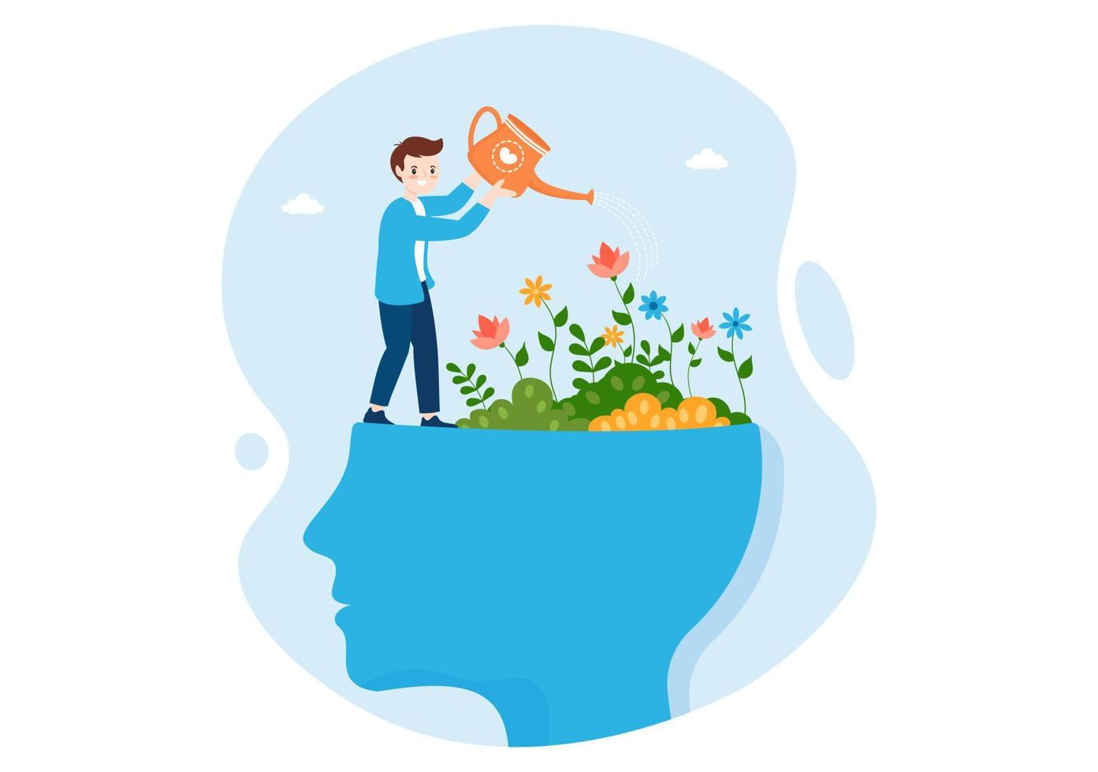
Holistic personality development
Presentation by : Avneet kaur ghumman, Ekta Sharma, Neetu kumari jha

Slide 2
Component of presentation
Introduction
Holistic personality development of students
Dimensions of Holistic personality development
Why Holistic personality development is Important
Role of Schools & Teachers
Role of Parents
Strategies for Students
Benefits of Holistic personality development
Conclusion

Slide 3
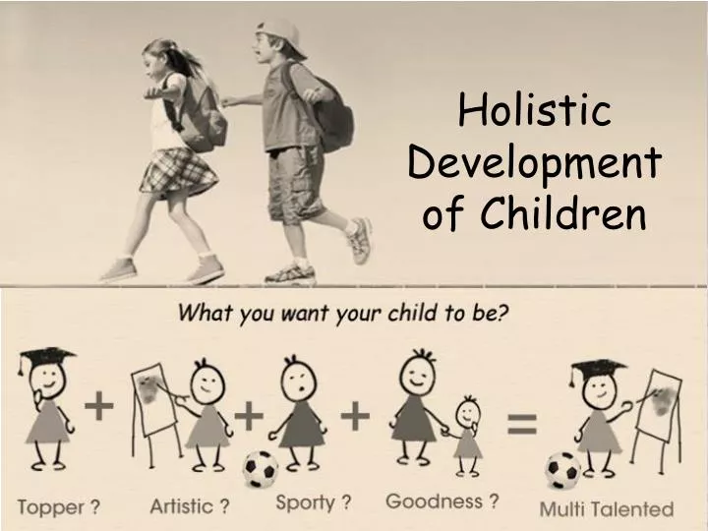
Introduction
  Personality = Combination of thoughts, feelings, behavior & attitude
  Holistic development focuses on: Body, Mind, Heart, and Soul
  Aim: Prepare students for life, not just exams

Slide 4
Holistic Personality Development of Students
Building Future-Ready, Responsible & Confident Individuals
Foster a Supportive Classroom
Fostering a student's complete growth beyond academics, focusing on their social, emotional, physical, intellectual, and ethical well-being

Slide 5
Dimensions of Holistic personality Development
  1. Intellectual Development – Knowledge, critical thinking, problem-solving
  2. Emotional Development – Self-awareness, empathy, stress management
  3. Social Development – Teamwork, communication, leadership
  4. Physical Development – Health, fitness, stamina
  5. Spiritual/Moral Development – Values, ethics, inner strength

Slide 6
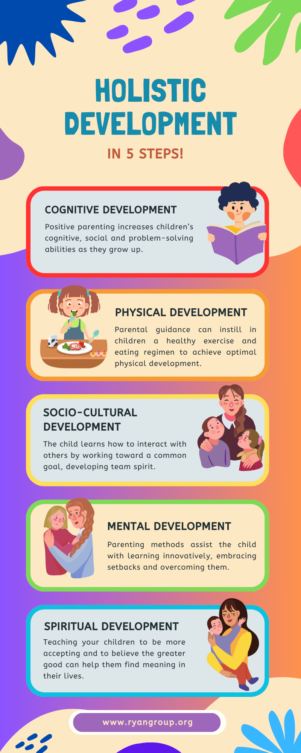

Slide 7
Why Holistic personality Development is
Important
  Builds confidence & self-esteem
  Improves academic and life skills
  Enhances decision-making
  Creates responsible citizens
  Helps in career success
  Preparation for life
  Well-rounded individuals

Slide 8
Role of Schools & Teachers
  Encourage creativity & curiosity
  Organize sports, debates, art & cultural activities
  Provide value-based education
  Promote collaborative learning
  Promote core skills
  Facilitates Diverse Experiences

Slide 9
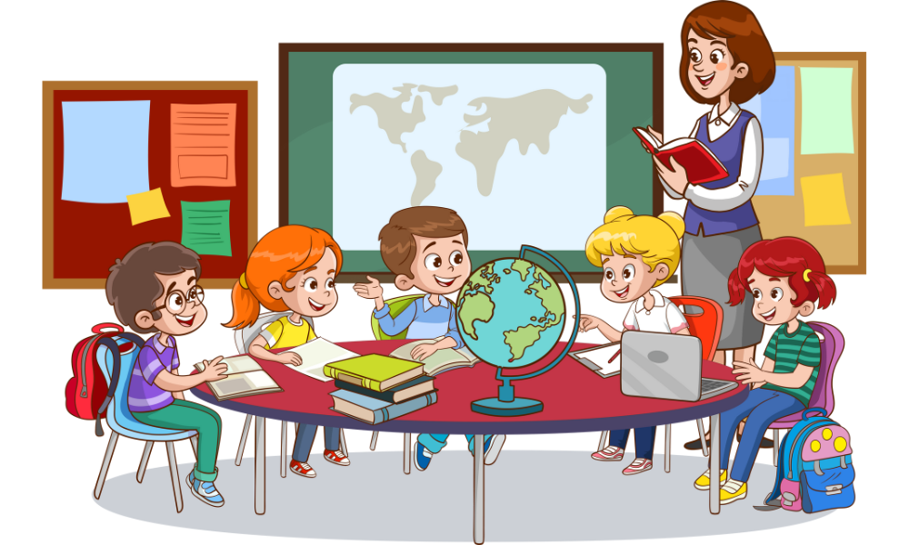

Slide 10
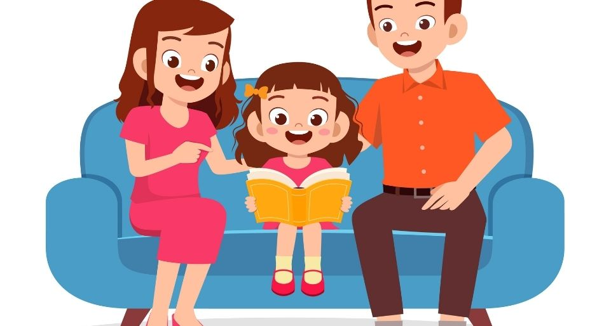
Role of Parents
  Positive home environment
  Encourage hobbies & interests
  Teach discipline, respect & empathy
  Balance between freedom & guidance
  Listen and Communicate
  Limit Screen Time

Slide 11
Strategies for Students
  Practice time management
  Develop good communication skills
  Participate in extracurricular activities
  Maintain healthy lifestyle
  Read, meditate, and practice gratitude
  Peer Support Groups

Slide 12
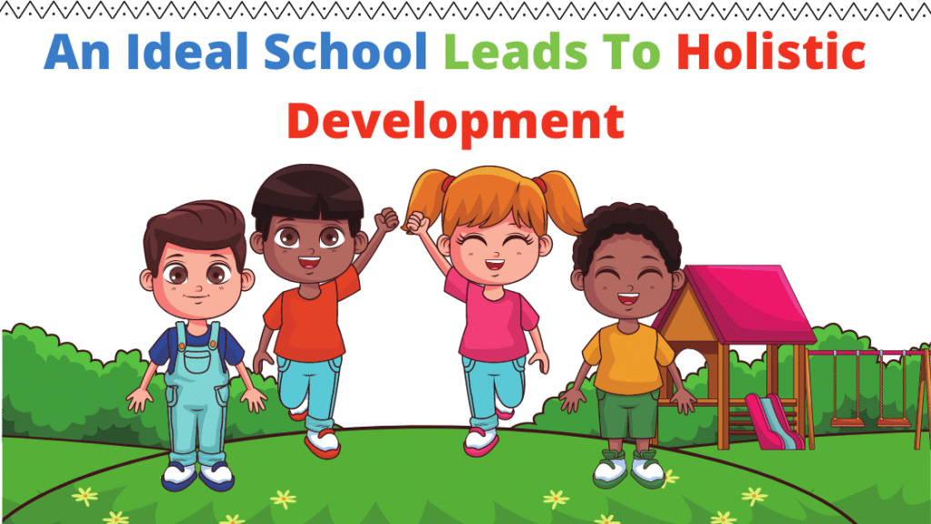

Slide 13
Benefits of Holistic Development
  Balanced personality
  Lifelong learning attitude
  Better adaptability in society
  Success in academics, career & relationships
  Encourages creativity
  Increases self-worth
  Increases motivation and engagement

Slide 14
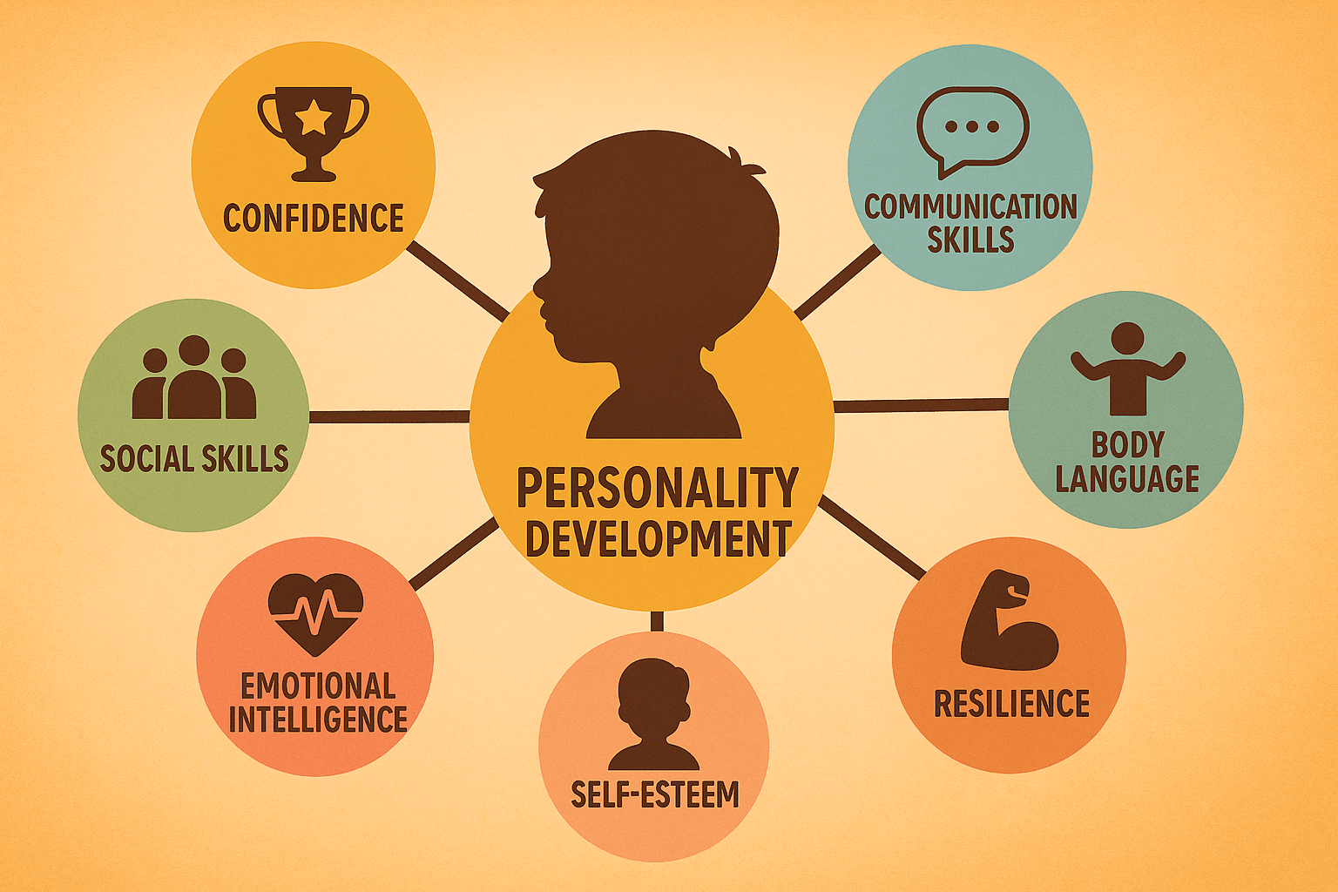

Slide 15
Conclusion
  True education = Beyond textbooks
  Holistic personality = Key to success, happiness & social harmony
  Let’s nurture students as future leaders with strong values.
  Promoting Lifelong Learning
  Integrate diverse teaching methods
  Promote emotional and social intelligence

Slide 16
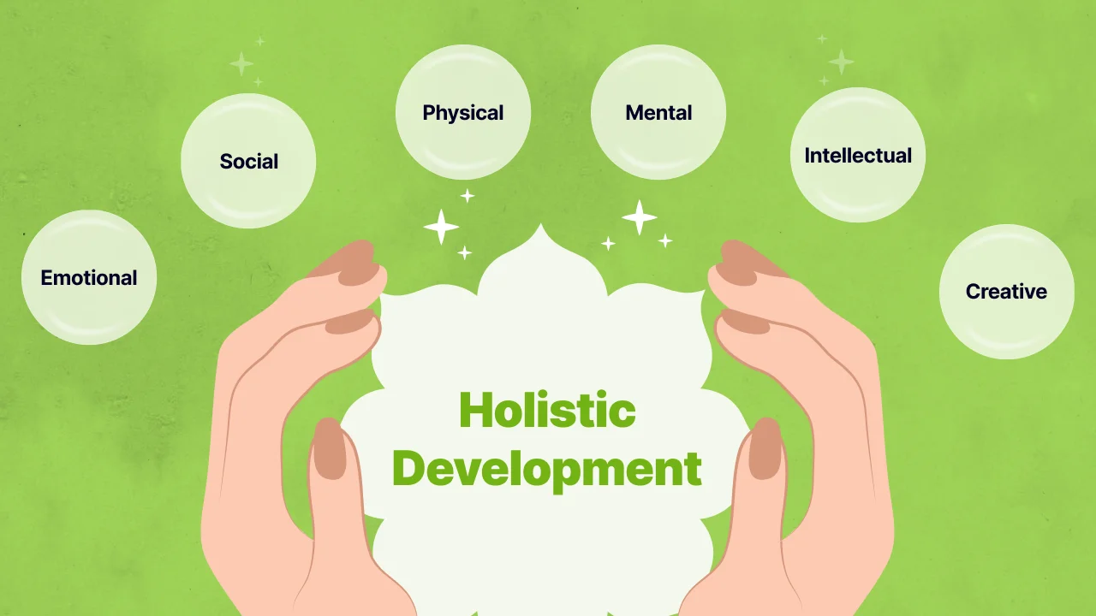

Slide 17
Thank You
“Education is not the learning of facts, but the training of the mind to think.” – Albert Einstein
“A teacher plants the seeds of knowledge, sprinkles them with love, and patiently nurtures their growth.” – Unknown

